Slide 1
Insignificant
“Treatment of non-musculoskeletal conditions represents an economically insignificant part of chiropractic practice – indeed, practice in these areas by chiropractors has delayed their general acceptance by the medical profession and the public.”
__________________________________
David Chapman-Smith
Secretary General – World Federation of Chiropractic
In: The Chiropractic Profession. Published by NCMIC

Slide 2
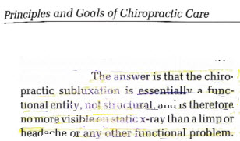
Subluxation not Structural
__________________________________
David Chapman-Smith
Secretary General – World Federation of Chiropractic
In: The Chiropractic Profession. Published by NCMIC

Slide 3
Subluxation Not Unique
“The concept is not unique to chiropractic. Its equivalents are the osteopathic lesion and the segmental blockage of the European manual medicine school.”
________________________________
David Chapman-Smith
Secretary General – World Federation of Chiropractic
In: The Chiropractic Profession. Published by NCMIC

Slide 4
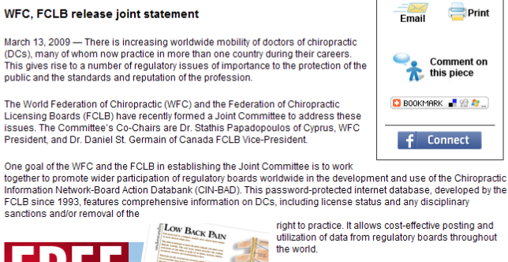
Protect the Public – From What?

Slide 5
Horror Stories
“What is an appropriate number and frequency of treatments for a patient with acute, uncomplicated low back pain, another with chronic headaches and a third wanting preventive care?
At one end of the scale there are horror stories of patients consulting a chiropractor who says that 100 treatments will be necessary to solve the complex problems of their spines, and that they can open up lump sum trust accounts at the office to cover payment. If this happens, refuse treatment, warn your friends and then call the state regulatory board.”
____________________________
David Chapman-Smith
Secretary General – World Federation of Chiropractic
In: The Chiropractic Profession. Published by NCMIC

Slide 6
Little Public Support
Currently there is limited public support for the idea that chiropractic care improves overall health
  ________________________________________
  World Federation of Chiropractic - Identity Consultation
WFC Assembly - Sydney, Australia - June 15, 2005

Slide 7
8 Weeks
“Some patients will only require one or a few treatments. If there is documented improvement after 4 weeks, but not complete relief of symptoms or restored function, the course of manipulation may continue. Typically it should end within 8 weeks for uncomplicated conditions, within 16 weeks for other conditions unless there has been major trauma or complications.”
___________________________________________
David Chapman-Smith
Secretary General – World Federation of Chiropractic
In: The Chiropractic Profession. Published by NCMIC

Slide 8
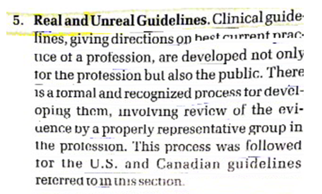
Remember Mercy?
___________________________________________
David Chapman-Smith
Secretary General – World Federation of Chiropractic
In: The Chiropractic Profession. Published by NCMIC

Slide 9
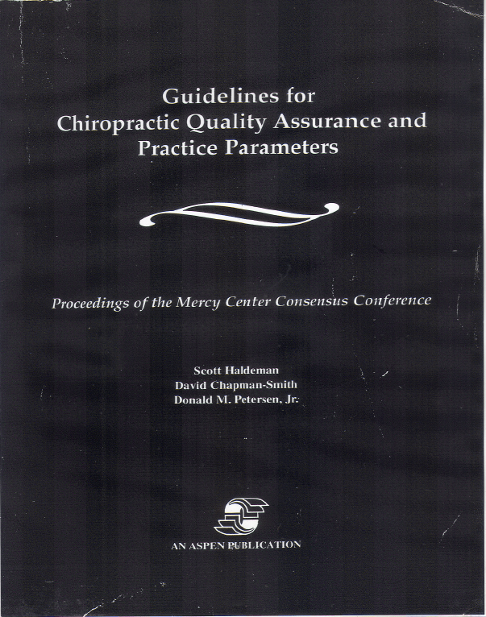
Chapman-Smith was one of the authors of the Mercy Guidelines

Slide 10
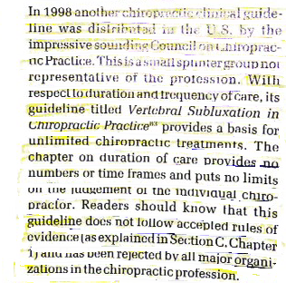
Then He Attacks Subluxation Guidelines
___________________________________________
David Chapman-Smith
Secretary General – World Federation of Chiropractic
In: The Chiropractic Profession. Published by NCMIC

Slide 11
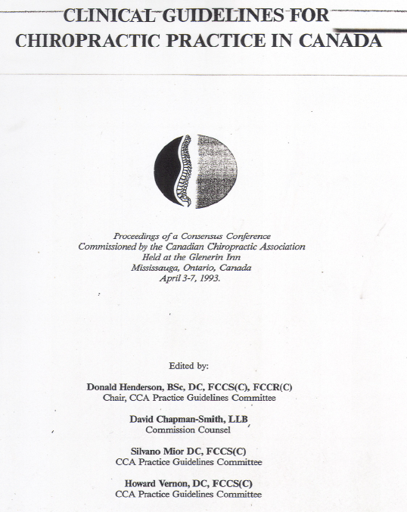
Chapman -Smith was also an author of these, which is a carbon copy of Mercy – even had the same typos.

