Slide 1
Chiropractic: A European Declaration
Serving society and our communities

Slide 2
Time for a Choice?
The Incident
Facing the Problem
Articulating Solutions
Declaring Intentions
Moving Forward

Slide 3
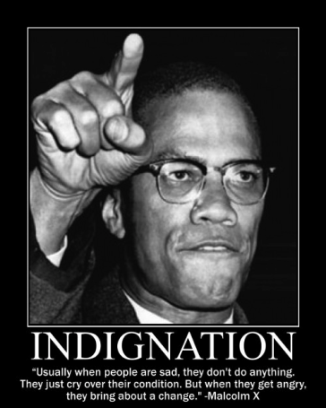
The Incident
An outrageous claim
An indignant complaint
A fundamentalists rebuff
The roar of the moderate majority
width and duration of discussion unusual in comparison with normal face book chatter
one post led to >1200 votes
Support for the stand, discussion and a willingness of large numbers of chiropractors to publically counter fundamentalism.
It IS time to stop ‘mistaking deviance as diversity’
Is it time to raise a flag and make clear OUR colours?

Slide 4
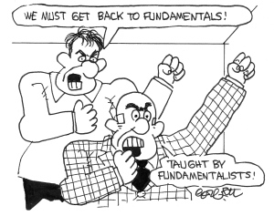
Facing the Problem
The Church Of Chiropractic
Lack of unity
Poorly articulated consensus
Perceived lack of passion
Poor counter propaganda
Silence as a strategy

Slide 5
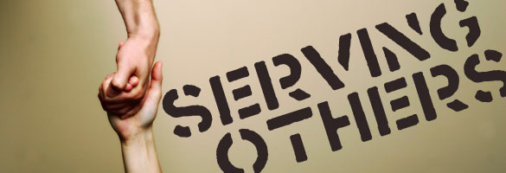
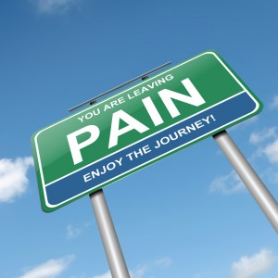
Articulating Solutions:
Looking out not in
Move from ‘who we are’ to ‘how we can serve’
Move from 'promoting the profession’ to ‘supporting the profession to better serve’
What needs for our patients, society and communities can we fulfill?
Supporting, Managing and Intervening to help shoulder the MSK burden

Slide 6
Articulating Solutions:
Clear boundaries
How we do this (who we are)
Core scope: MSK specialists (spinal?)
Core approaches: Manual/Physical, Psychosocial, Public Health
Core grounding: Evidence based
How we do NOT do this (who we are NOT)
Mono therapeutic (judicious use of the adjustment)
Mono theorised (subluxation theory unnecessary and divisive)
Theistic (publicly eschewing vitalism and energy flow)

Slide 7
Articulating Solutions:
Pulling Together
How do we train our graduates
Evidence Based MSK Support, Management and Intervention
Dynamic curriculum review to keep up with change linked to ECCE accreditation
Who do we work with
Anyone necessary to help shoulder Society’s and our communities’ MSK burden
What do our educational, political and professional institutions do?
Support the profession to better fulfill our societal and community based obligations regarding MSK support, management and intervention

Slide 8
Declaring Intentions
A set of consensus statements
There is a message vacuum and in its absence students are gravitating toward the only messages there are
Adopted/supported by all European associations, educational institutions and political bodies
Present on websites
Guides policy, education and identity

Slide 9
Declaring Intentions
Inspiring champion presentations
HE Institutions
ECU and National Association conferences
Leveraging social media
European Chiropractic Group
Removal if break rules (‘congratulations, you have achieved my blocked list. Please take these courses and get back to us’)
Liam Schubel already has a Facebook closed group for European Chiropractors (Chiropractic Awareness Europe 1)

Slide 10
Moving Forward
Post graduate training year
Structured, supported, intensive
Key chiropractic clinicians?
Align education and political policy to
Emerging MSK needs and associated problems as seen by European health care policy (e.g., MSK Health: A Public Health Approach)
Engaging with others to support MSK burden
Letting go of the idea that we will be the MSK gate keepers and focus on being part of a team?
Take the risk of being 'Good for Nothing'

