Slide 1
Subluxation-Centered Outcomes and Advanced Imaging – a Research Agenda
Christie Kwon MS, DC, MPH(c)
FCS 2019 – C.E., 2 hours

Slide 2
Course Outline
Hour #1 fMRI as an Outcomes Assessment Tool for Subluxation-Centered Chiropractors
Discuss the importance of objective assessment and outcome measures in the practice of subluxation-based chiropractic care
Review the basics of Advanced Imaging/fMRI
BOLD Effect
Statistical Mapping
Establishing research questions that can be answered through fMRI
Hour #2 An Advanced Imaging Research Agenda for the Subluxation-Based Chiropractic Profession
Discuss the importance of research within a focused agenda to help explore and validate the practice of subluxation-based chiropractic care.
Explore basic practice-based research methodology
Discuss trends in healthcare and evidence informed practice
Provide resources for guidance to conduct research

Slide 3
Hour 1
fMRI as an Outcomes Assessment Tool for Subluxation-Centered Chiropractors
Discuss the importance of objective assessment and outcome measures in the practice of subluxation-based chiropractic care
Review the basics of Advanced Imaging/fMRI
BOLD Effect
Statistical Mapping
Establishing research questions that can be answered through fMRI

Slide 4
Evidence-based OR Subluxation-based?

Slide 5
An Evidence Base for Subluxation-Based Chiropractic

Slide 6
What evidence are you willing to consider?

Slide 7
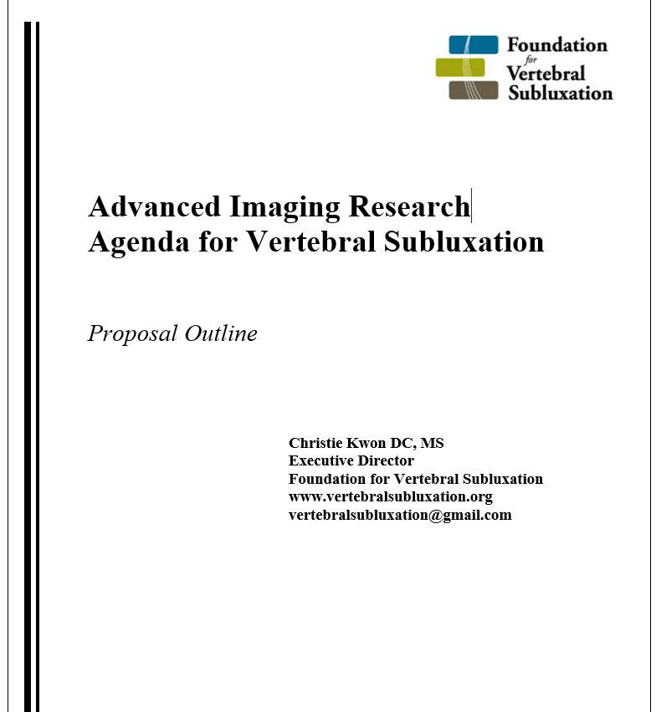
What We HAVE Measuring Components of VSC
X-ray
Videofluoroscopy
CT
MRI
Computerized Muscle Testing
Surface Electromyography
Needle Electromyography
Somatosensory Evoked Potentials
Dermatomal Evoked Potentials
Current Perception Threshold
Nerve Conduction Velocity
Visual & Auditory Evoked Potential
Thermography
Heart Rate Variability
fMRI
SPECT
PET
Laboratory (Blood) Work
Quality of Life Surveys

Slide 8
OATS - Imaging
A number of chiropractic techniques rely on x-rays in order to determine the misalignment (biomechanical) component of the vertebral subluxation
Imaging (especially plain film) is the only objective, valid and reliable method to make that determination
May also be necessary to determine whether or not the misalignment has been reduced or corrected.
Other red flags may only be visualized by imaging

Slide 9
Imaging
Plain film x-ray imaging has served as an objective means of analysis of the biomechanical/misalignment aspect of VSC for decades
Wilhelm Roentgen discovered the X-ray beam in 1895!

Slide 10
OATS - Instrumentation
Thermography, Heart Rate Variability, Surface EMG, etc.
“A window to the nervous system”
The premise of chiropractic and correction of the vertebral subluxation recognizes both biomechanical and neurological components
Objective tools are necessary to examine the nervous system
Some techniques use these tools as indicators of when an adjustment is necessary
Outcomes can be measures with validity and reliability using these tools

Slide 11
OATS – Instrumentation (HRV)
According to Harvard University researchers
High HRV may be a leading indicator of health
Variability in beat-by-beat heart period is an intrinsic characteristic of healthy cardiac functioning.
Various stressors result in characteristic changes in variability and various disease states are associated with lesser variability
→ Adaptation!
Research suggests autonomic dysfunction may substantially contribute to organ failure, cardiovascular disease, and associate with disorders such as PTSD, poor executive function & self-regulation

Slide 12
OATS – Subjective QoL
Subjective, patient-reported measures of physical, mental, and social health are important indicators
They can be used to assess function, behaviors, and feelings
Many widely validated tools exists
Essential to patient-centered care
May reveal outcomes independent of symptoms
Data can be compared to a broad pool

Slide 13
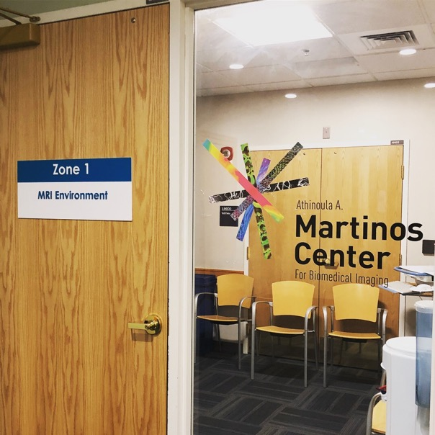
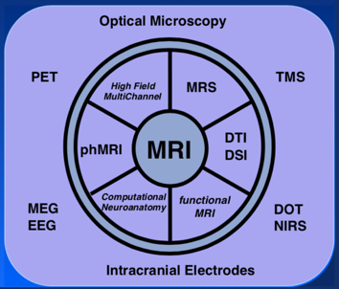
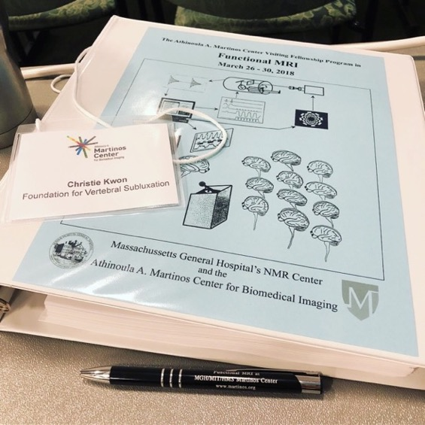
Measuring the Immeasurable
Advanced Imaging allows chiropractors to observe neurological and physiological changes related to the presence and correction of VSC
Neurochemistry
Neuroanatomy
Neurophysiology
Columnar Wiring
Brain Mapping
Psychology
Sociology

Slide 14
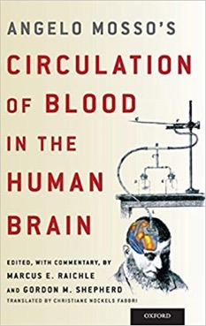
BOLD Effect
Blood-Oxygen level dependent contrast;
Hb has different magnetic properties when oxygenated and deoxygenated
2
4
The Body is Efficient
The brain always receives the amount of oxygen it needs → relatively little change in O2 consumption
Time-Based Series
Captures a sequence of activity in a particular region of the brain over time
6
1
3D Images Pictures
Obtains images of brain structures using magnetic fields and radio waves (NMR – nuclear magnetic resonance)
5
Increased T2 Signal
Increased venous O2 &
Reduced deoxy-Hb
3
Hemodynamic Response
Local increases in blood flow and volume when neuronal activity is triggered

Slide 15
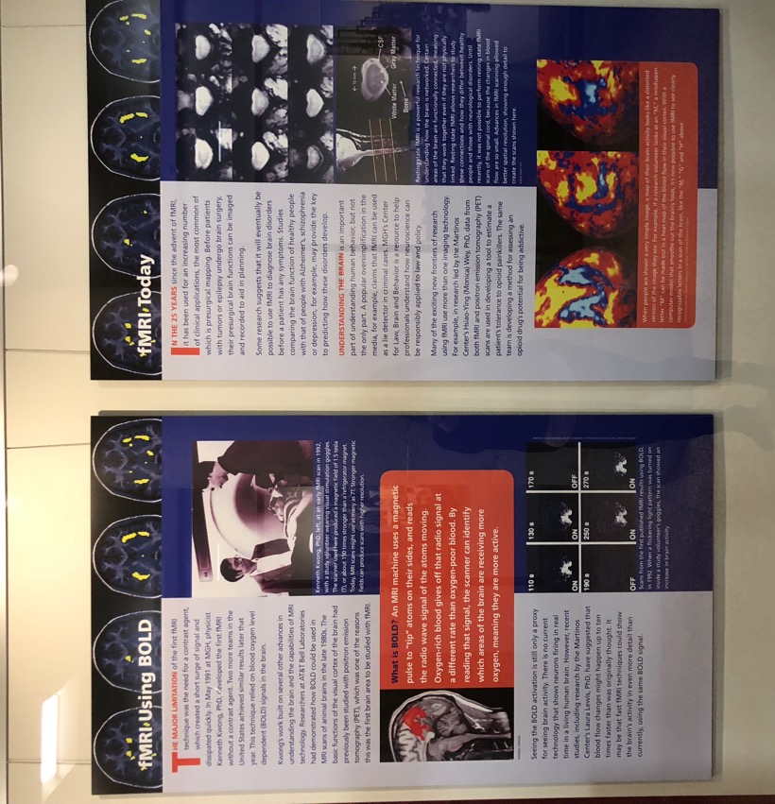

Slide 16
The Basics of Functional MRI – MR Physics
Nuclear Magnetic Resonance (NMR) signal – 3 magnetic fields
Proton excitation by electrons
Tissue with more protons per cc gives more signal and is thus brighter on the image
Relaxation of subatomic particles
Gradient fields to create “slices”
Time between activation (dephasing)
Magnet strength (up to 7 Tesla)
Hemodynamic Response

Slide 17
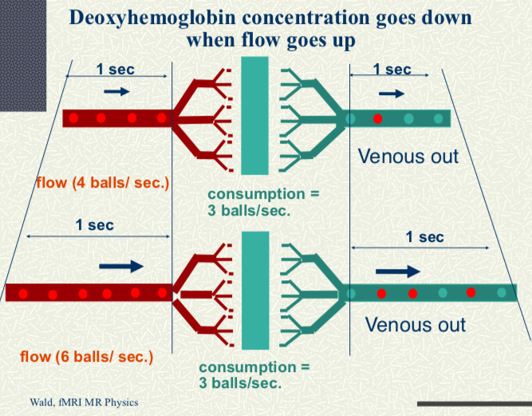

Slide 18
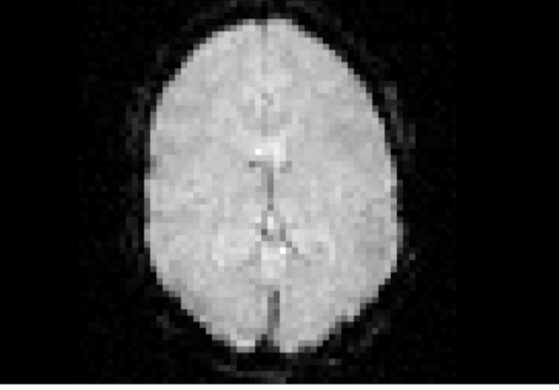
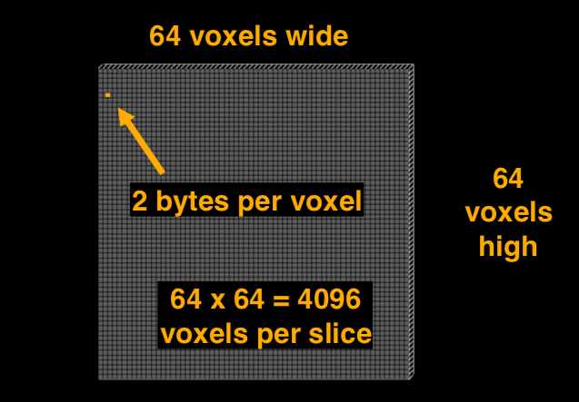
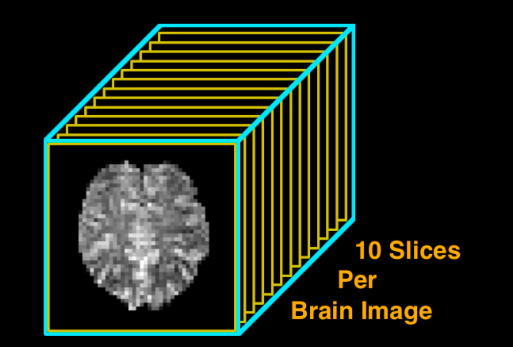
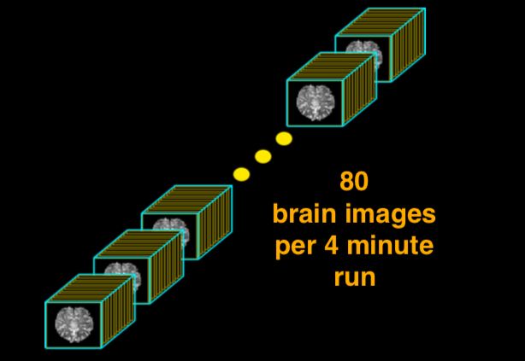

Slide 19
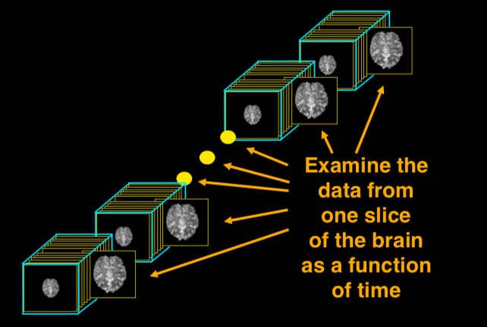
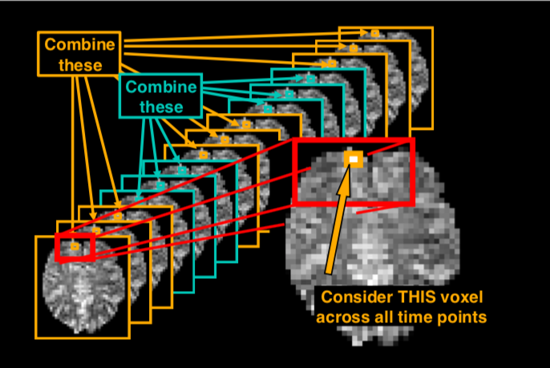
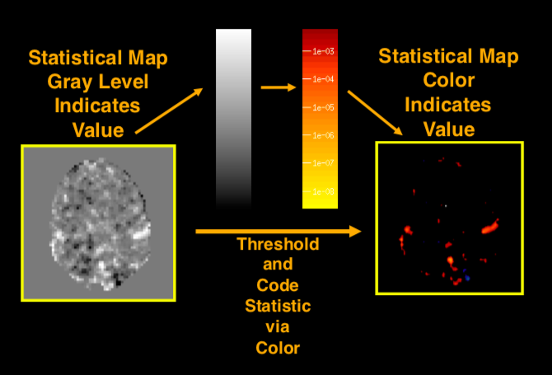
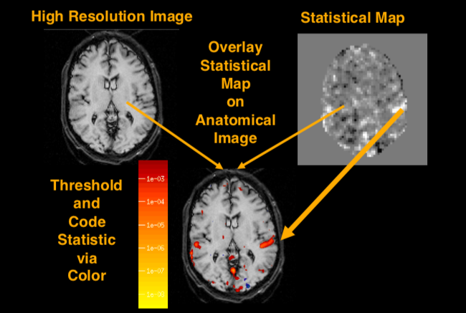

Slide 20
High
temporal
resolution
Non-ionizing
Better, and ever-improving, spatial resolution at high speed
Repeated studies on single subjects
Can be used to image the brain and spinal cord
Can measure activity at rest and with tasks
Many clinical applications
Task-oriented responses
Resting state neural connectivity
CSF flow

Slide 21
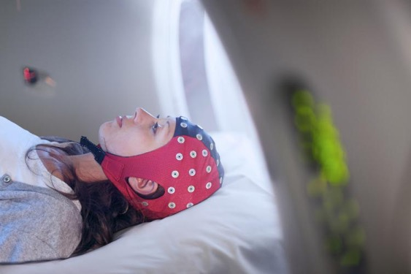
What can fMRI demonstrate?
Simultaneous fMRI and continuous-time heart rate variability (HRV) recording can be used to estimate central autonomic processing

Slide 22
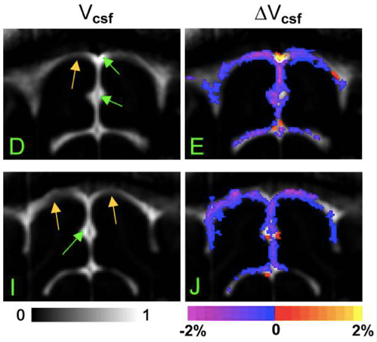
What can fMRI demonstrate?
Task-oriented responses
Resting state neural connectivity
CSF flow
A connection
between
philosophy and
science

Slide 23
What are the research questions?
How does the subluxation interfere with connections within the brain and between the brain and body?
How does the chiropractic adjustment reduce those interferences?
Can we see innate at work?

Slide 24
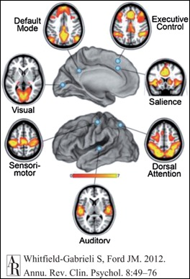
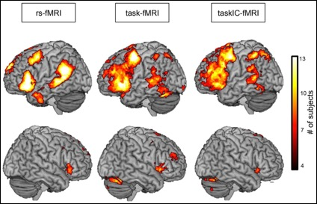
CONNECTION
The body is capable of self-regulation, self-healing, and health maintenance

Slide 25
Hour 2
An Advanced Imaging Research Agenda for the Subluxation-Based Chiropractic Profession
Discuss the importance of research within a focused agenda to help explore and validate the practice of subluxation-based chiropractic care.
Explore basic practice-based research methodology
Discuss trends in healthcare and evidence informed practice
Provide resources for guidance to conduct research

Slide 26
A Subluxation-centered Public Health Campaign
In order to establish the presence of vertebral subluxation as an imminent public health threat, we must first show:
The general public is subluxated
Subluxations are affecting people’s health
Chiropractic adjustments correct these subluxations,
And allow people to experience better health

Slide 27
Population-Based Prevention
Shift entire
population
to the left
Risk

Slide 28
The General Questions What Do We Think? What Do We Know?
We think…
Chiropractic care is essential for optimum health
Subluxation correction leads to improved health outcomes
According to the 33 Principles:
There can be interference with the transmission of Innate forces (29);
Interference with the transmission of Innate forces causes incoordination or dis-ease (30);
Interference with transmission in the body is always directly or indirectly due to subluxations in the spinal column (31);
Innate Intelligence adapts forces and matter for the body as long as it can do so without breaking a universal law, or Innate Intelligence is limited by the limitations of matter (24).
The chiropractic adjustment allows for the fullest expression of innate intelligence

Slide 29
The General Questions What Do We Think? What Do We Know?
We know…
The body is a self regulating, self maintaining organism;
The nervous system controls and coordinates all functions of the body;
The spine and vertebrae house and protect the nervous system;
We think…
Vertebral subluxations can occur and interfere with the function of the nervous system;
Reducing and/or correcting vertebral subluxations allows the nervous system to function better and allows the fullest expression of life.

Slide 30
The Vertebral Subluxation Complex
Vertebral subluxations are changes in the position or motion of a vertebra (kinesiologic dysfunction), which result in the interference with nerve function (neurologic involvement)
What is its operational definition?
A precise statement of how a conceptual variable is turned into a measured variable

Slide 31
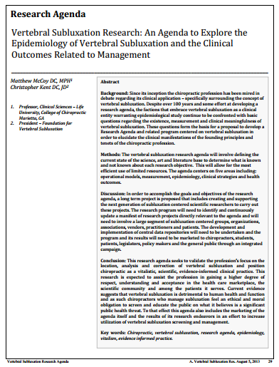
www.vertebralsubluxation.org

Slide 32
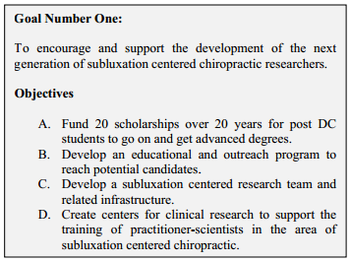
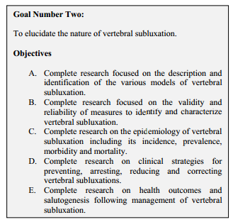

Slide 33
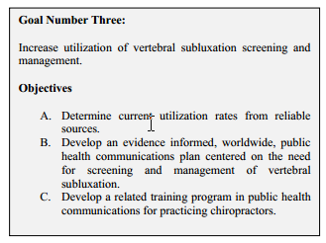

Slide 34
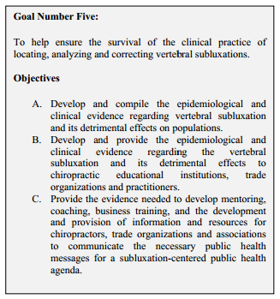

Slide 35
Where are we today?
According to PwC’s Health Research Institute (HRI)
Medical cost growth rate is estimated to be 6.5% and has outrun general economic inflation in the U.S
Pharmaceutical companies have increased spending in advertising from $3.83 billion to $5.4 billion and were rewarded by an increase in sales from $328 billion to $413 billion.
Cost-effectiveness for complementary and integrative care demonstrated in 28 separate studies, according to RAND Corp. and Harvard University
CAM utilization and integration leads to 43% reduction in use of medical services, in a study by Massachusetts General Hospital

Slide 36
Where are we today?
Iatrogenic disease deaths rank 3rd in the U.S.
Over 250,000 deaths per year are due to medical error in the U.S. (BMJ – JHU 2016)
The opioid epidemic is projected at $78.5 billion a year, including the costs of healthcare, lost productivity, addiction treatment, and criminal justice involvement
For 3 consecutive years, life expectancy has decreased

Slide 37
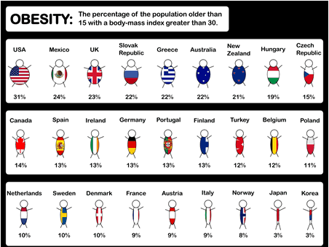

Slide 38
Prevention
Today, 7 in 10 deaths in the U.S. are related to preventable diseases such as obesity, diabetes, high blood pressure, heart disease, and cancer, and 75% of our health care dollars are spent treating such diseases. However, only 3% of our health care dollars go toward prevention.
The lifetime risk of diabetes for babies born in 2000:
1 in 3 for males
2 in 5 for females
Narayan KM, et al. JAMA290 :1884 –1890,2003

Slide 39
80% of Americans worry a fair-great deal about healthcare access and affordability
3.85 M babies were born in the U.S. in 2016
World Health Organization (WHO)
A state of complete physical, mental, and social well being, and not merely the absence of disease or infirmity
U.S. health care spending grew 3.9%, reaching $3.5 trillion or $10,739 per person - about 17.9% of the nation’s GDP – in 2017

Slide 40
38% of adults and 12% of children in the US utilize CAM
Utilization is higher at higher socioeconomic levels
Median global utilization of chiropractic services has been estimated at 9.1%
More females seek chiropractic, and often for non-pain-based reasons
A lack of knowledge about benefits and costs are cited as primary barriers to seeking care

Slide 41
High satisfaction & improvement related to fatigue, pain interference, sleep disturbance, satisfaction with social roles, and quality of life
343
75%
A PROMIS-based survey study of 343 pregnant patients
Percentage of patients who shared their experiences with PCPs, OB/GYNs, or midwives
Wk 25
The average time in pregnancy that patients began care
Overall satisfaction with chiropractic and also experienced physical and mental health benefits

Slide 42
What is the real challenge?
What is your question?
What would the answer look like?
Why should we believe your answer?

Slide 43
The Critical Mass
Prudent & want proven, reliable services

Slide 44
The Research Agenda
What is your question?
Does the presence of VSC affect neurologic and physiologic activity?
Does location, analysis, and correction/reduction of VSC influence/improve activity?
What would the answer look like?
Can changes to hemodynamic response and neural connectivity be demonstrated pre and post care?
Do these changes correlate with other established outcome measures?
Why should we believe your answer?

Slide 45
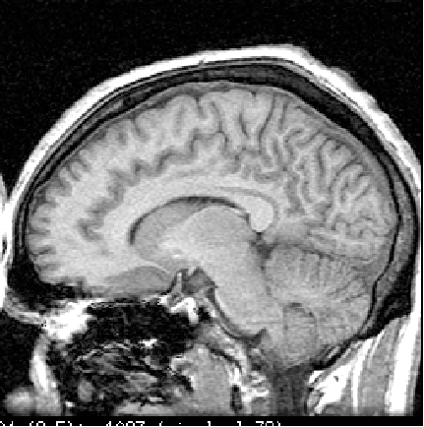
Brain Coverage
Striatum
Insula
Orbitofrontal Cortex
Nucleus Accumbens
Amygdala

Slide 46
Information Literacy
“…the ability to know when there is a need for information, to be able to identify, locate, evaluate, and effectively use that information for the issue or problem at hand.”

Slide 47
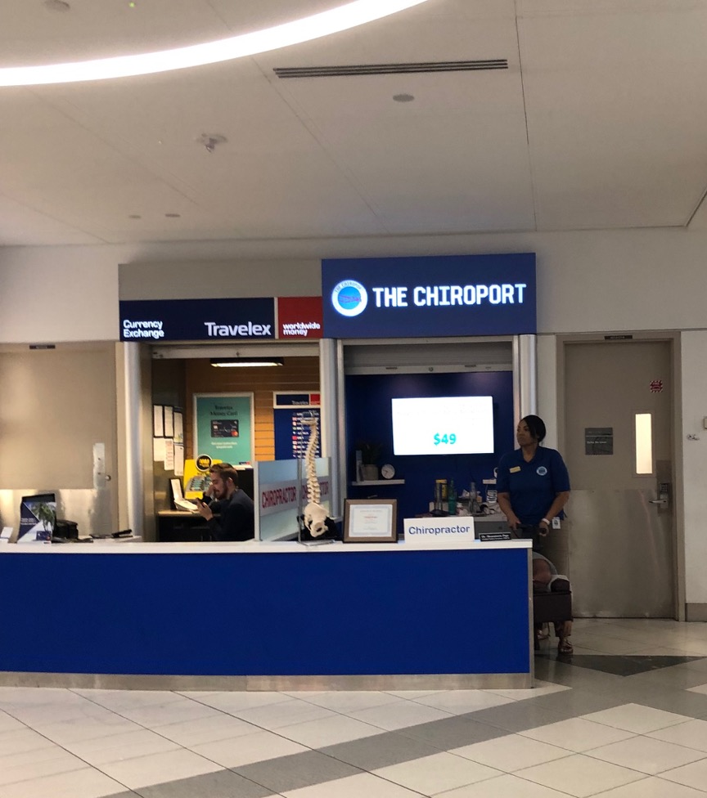
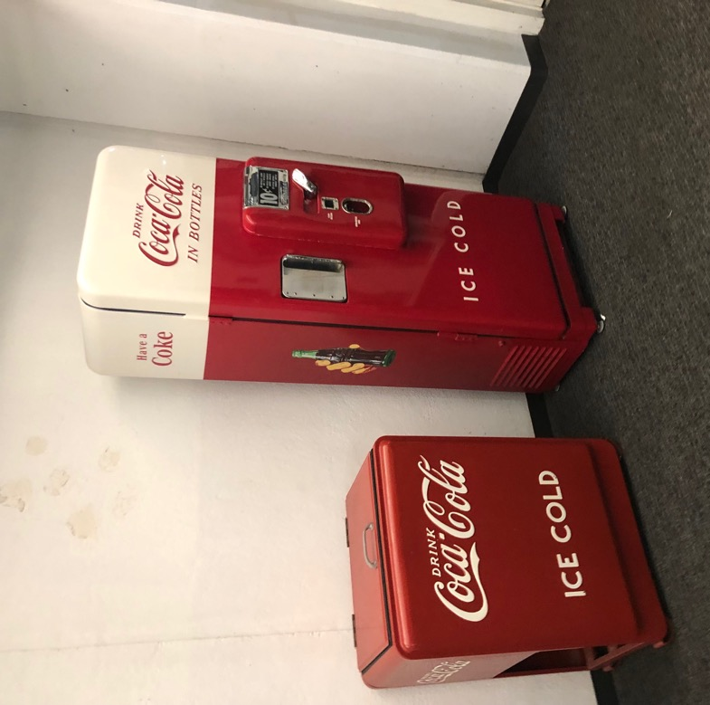
Wholesale vs. Retail

Slide 48
Practice-Based Research Networks
Why join a PBRN?
A PBRN becomes the “clinical laboratory” for chiropractic patient outcomes
Collaborative effort strengthens the statistical power of a study
Provides practitioners an opportunity to directly contribute to the research evidence
Reduces the need for individual study development and paperwork, fees, etc.
Allows us to work together to improve the health of all of our patients

Slide 49
Central Data Repositories
An aggregation of stored data in some place such that it can be shared, updated, analyzed and secured by every user
An Evidence
Base for
VSC
Anecdotal
Evidence

Slide 51
Thank You!
Christie Kwon MS, DC, MPH(c)
vertebralsubluxation.ckwon
@gmail.com

